Slide 1
Systems Analysis and Design CT026-3-1
Prototyping and Interface Design

Slide 2
Topic & Structure of The Lesson
Interface Design:
Discuss the objectives of input design
Identify the types of input design devices
List the guidelines of input design
Form Design

Slide 3
Learning Outcomes
By the end of this lecture, YOU should be able to :
Design an interface design
Input Design
Devices
Guidelines for form design

Slide 4
Key Terms you must be able to use
If you have mastered this topic, you should be able to use the following terms correctly in your assignments and exams:
speciality forms
Logical Design
Physical Design

Slide 5
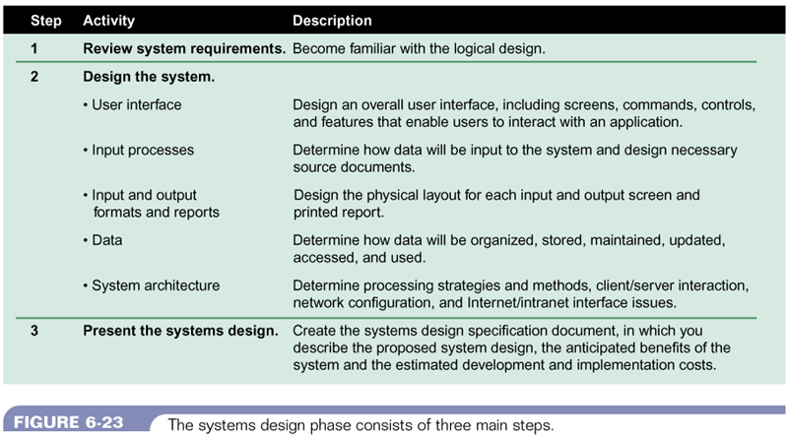
Three steps of the systems design phase
Figure 11-1 : Three steps of systems design phase
Systems Analysis & Design (4th Edition) – Shelly Cashman Series.

Slide 6
Logical Design
logical or conceptual relationships among the components of the IS
defines all
the outputs that must be produced by the system
the inputs needed by the system
the processes that must be performed by the system
is concerned with what the system must accomplish

Slide 7
Physical Design
a plan for the actual implementations of the logical design of the system
describes the implementation of of all components of the Information Systems
e.g. – describes actual processes of entering, verifying, and storing data; the physical layout of data files; the sorting procedures; the exact format of the reports

Slide 8
Difference between logical and physical design
LOGICAL DESIGN | PHYSICAL DESIGN
is concerned with what is required | is concerned with how the requirements are satisfied
what data will be input to the system | how the data is input
what processes must be performed | how is the data stored and processed
what information will be output | how the output is processed
what constraints must be met | how the constraints are met
is completed during the systems analysis phase | is completed during the systems design phase

Slide 9
Quick Review Question
What’s the main difference between logical design and physical design?

Slide 10
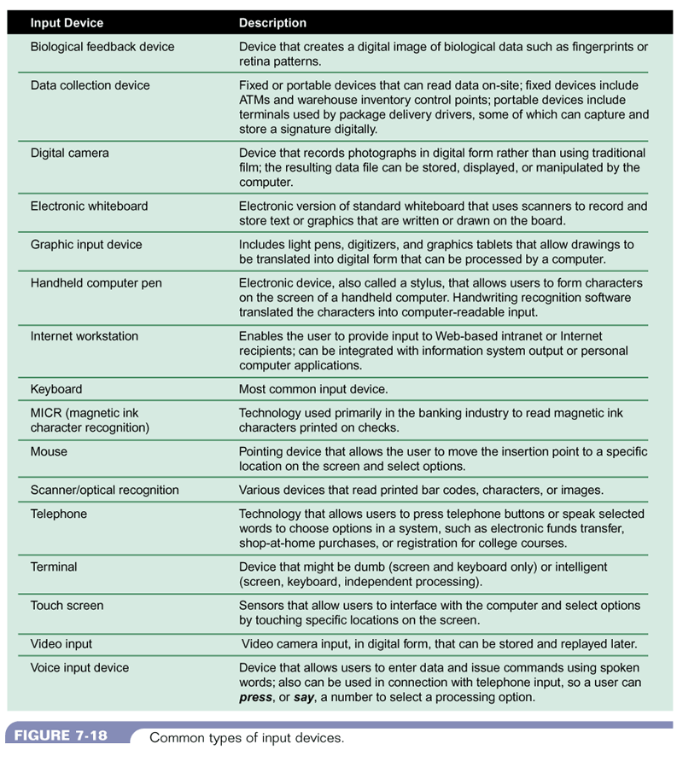
Input Device
Figure 11-8 : Input Devices – (a)
Systems Analysis & Design (4th Edition) – Shelly Cashman Series.

Slide 11
Input Device
Figure 11-9 : Input Devices – (b)
Systems Analysis & Design (4th Edition) – Shelly Cashman Series.

Slide 12
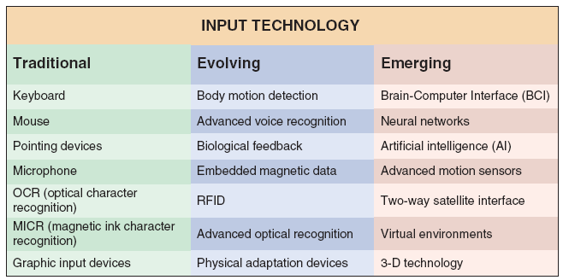
Input Technology
FIGURE 8-22 Input devices can be very traditional, or based on the latest technology

Slide 13
Input Design Objectives
Ease of use
Effectiveness
Accuracy
Attractiveness
Simplicity
Consistency
http://cs.stanford.edu/people/eroberts/cs201/projects/2010-11/PsychologyOfTrust/ui3.html#0

Slide 14
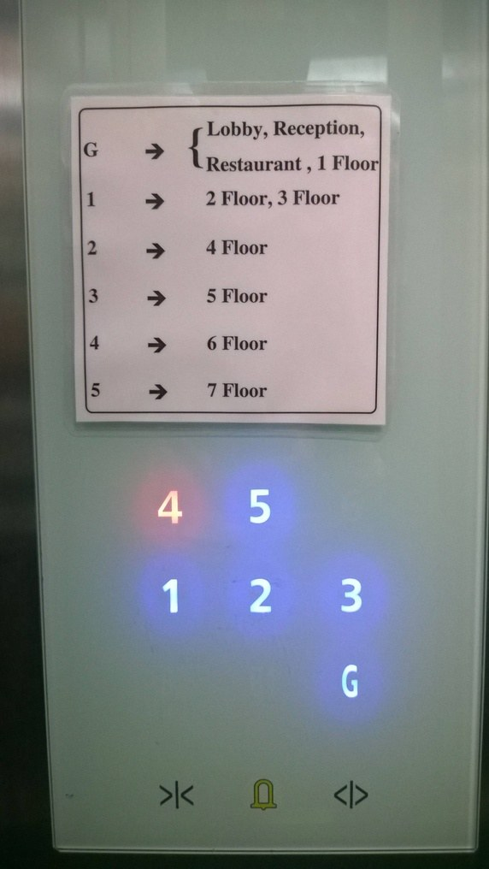
Poor Design

Slide 15
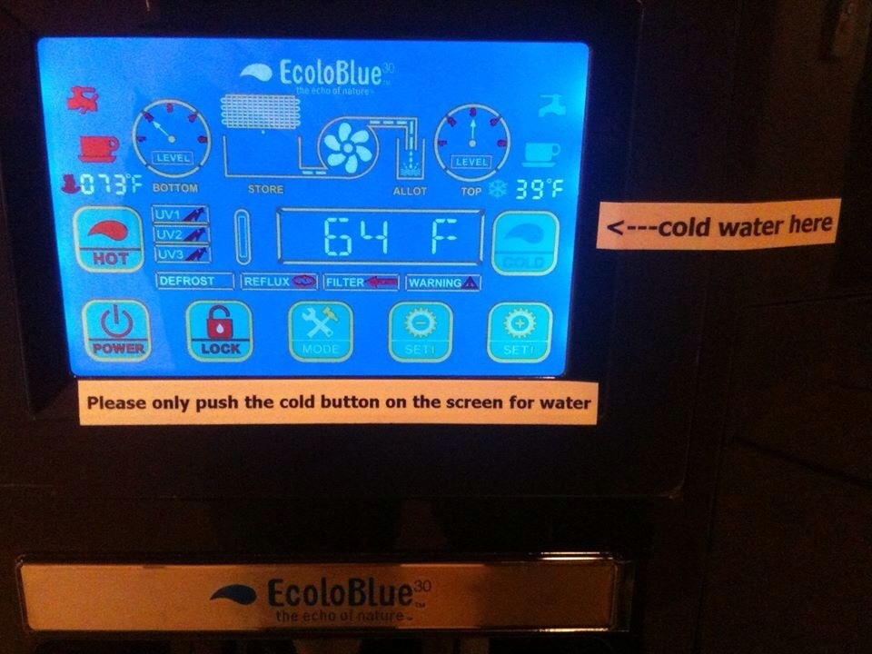

Slide 16
Forms
preprinted or duplicated papers that require people to fill in responses in a standardized way
serve as source documents for data entry personnel or for input to e-commerce applications

Slide 17
GUIDELINES FOR FORM DESIGN
Make forms easy to fill in
Ensure that forms meet the purpose for which they are designed
Design forms to ensure accurate completion
Keep forms attractive

Slide 18


Slide 19
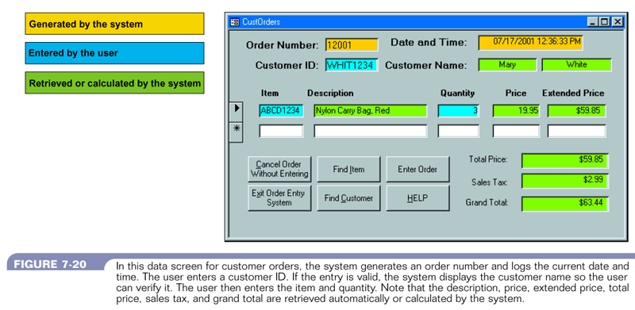
Make forms easy to fill in
Figure 11-10 : Sample form
Systems Analysis & Design (4th Edition) – Shelly Cashman Series.

Slide 20
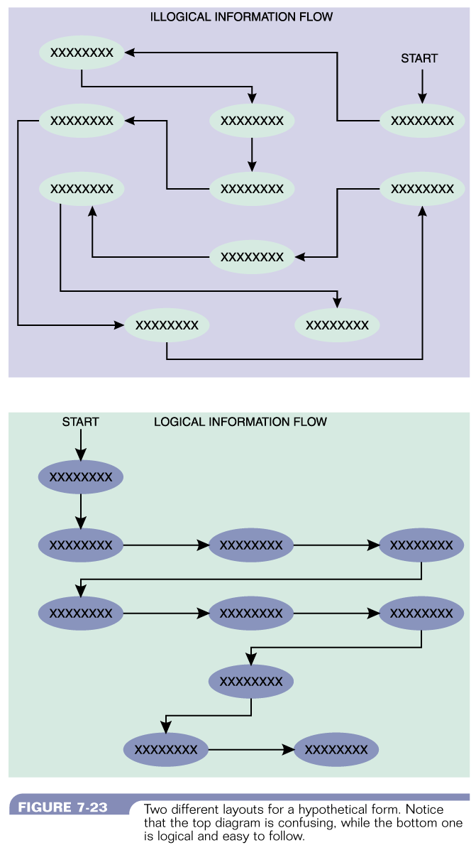
Make forms easy to fill in
Form Flow
Figure 11-11 : Illogical Information Flow
Systems Analysis & Design (4th Edition) – Shelly Cashman Series.
Figure 11-11 : Information Flow
Systems Analysis & Design (4th Edition) – Shelly Cashman Series.

Slide 21
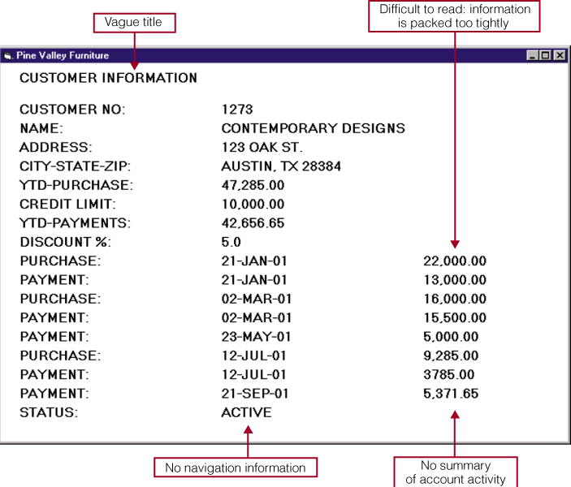
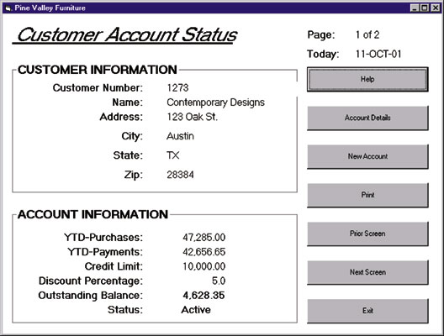
Make forms easy to fill in
Grouping of Information
Figure 11-11 : Illogical Grouping of Information
Systems Analysis & Design (4th Edition) – Shelly Cashman Series.
Figure 11-12 : Logical Grouping of Information
Systems Analysis & Design (4th Edition) – Shelly Cashman Series.

Slide 22
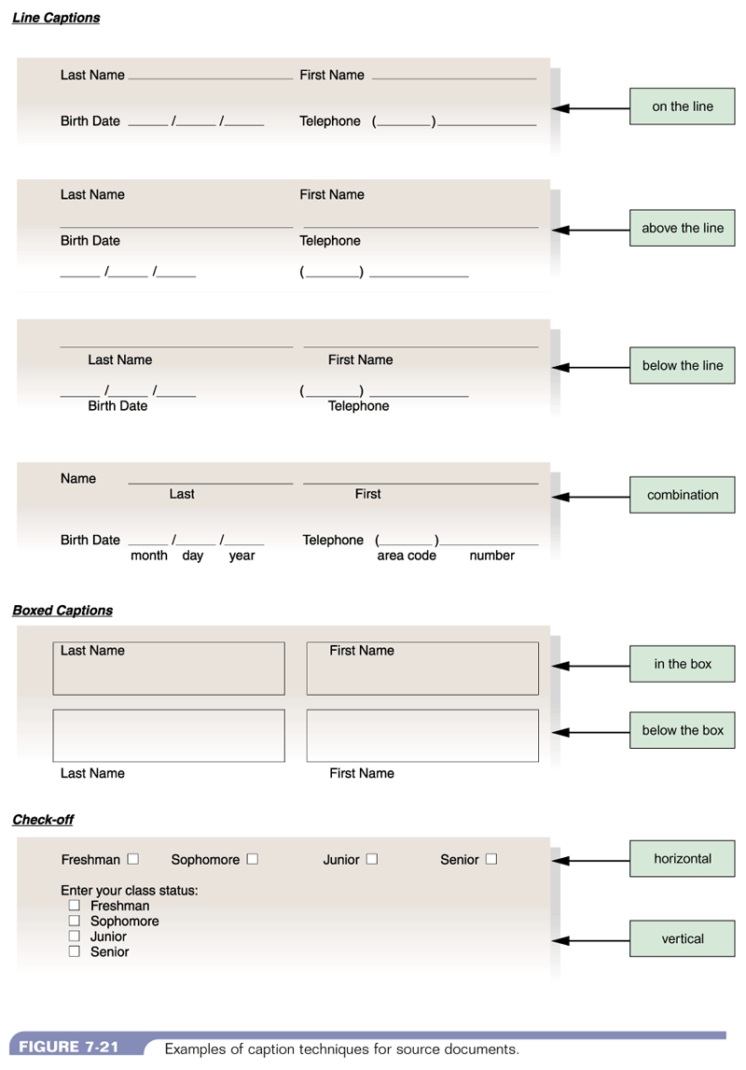
Make forms easy to fill in
Captions – Line Captions
Figure 11-13 : Line Captions
System Analysis and Design, 5/e - Kenneth E. Kendall & Julie E. Kendall

Slide 23
Make forms easy to fill in
Captions – Boxed Captions
Figure 11-14 : BoxedCaptions
System Analysis and Design, 5/e - Kenneth E. Kendall & Julie E. Kendall

Slide 24
Make forms easy to fill in
Captions – Check-off
Figure 11-15 : Check-ff Captions
System Analysis and Design, 5/e - Kenneth E. Kendall & Julie E. Kendall

Slide 25

Make forms easy to fill in
Input Validation
Hints and Labels

Slide 26
Ensure that forms meet the purpose
specialty form
forms which provide different information to different departments or users
use of it
could be costly
could cause users to be strangled with red tape
due to meaningless multiple-part forms

Slide 27
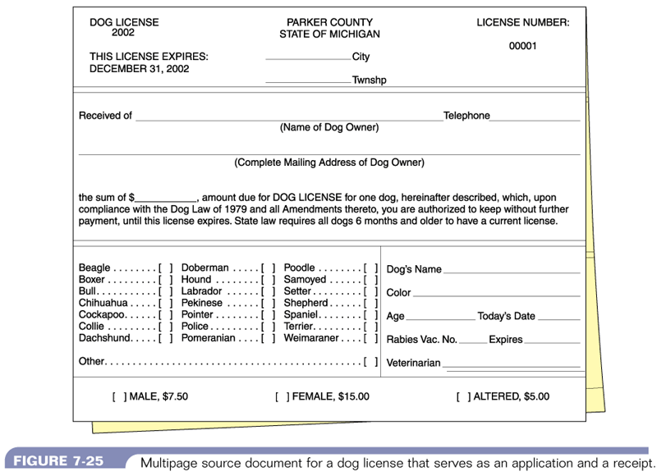
Ensure that forms meet the purpose
Figure 11-16 : Sample of a specialty form
System Analysis and Design, 5/e - Kenneth E. Kendall & Julie E. Kendall

Slide 28
Design form to ensure accurate completion
to reduce errors
Design so that people are doing the right thing with the form

Slide 29
Keep forms attractive
forms should look uncluttered
appear organized and logical – provide enough space
follow a special order – name, street address, city, state, zip or postal code, country
layout & flow
suggestions
use different fonts for type within the same form
separate categories & subcategories with thick and thin lines

Slide 30
GUIDELINES FOR SCREEN DESIGN
Keep the screen simple
Keep the screen presentation consistent
Facilitate user movement among screens
Create an attractive screen

Slide 31
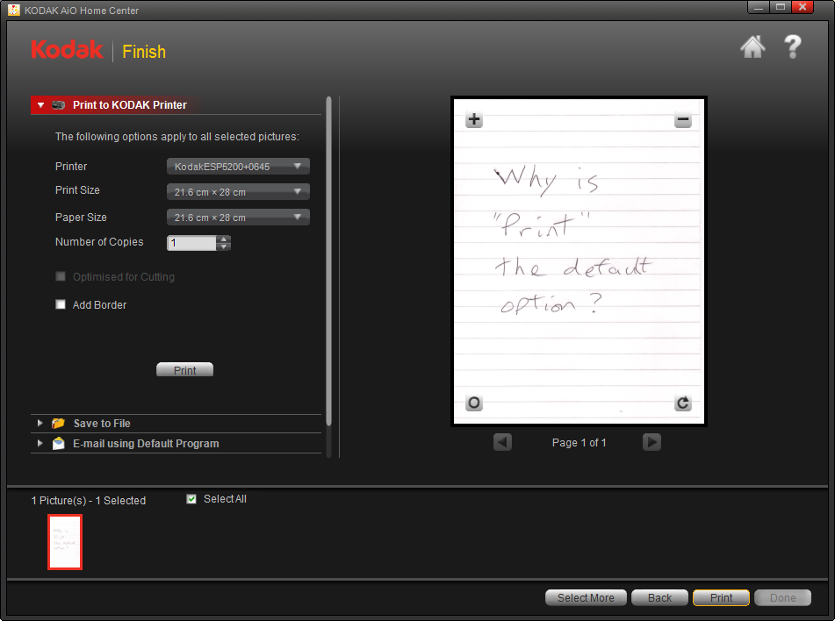

Slide 32
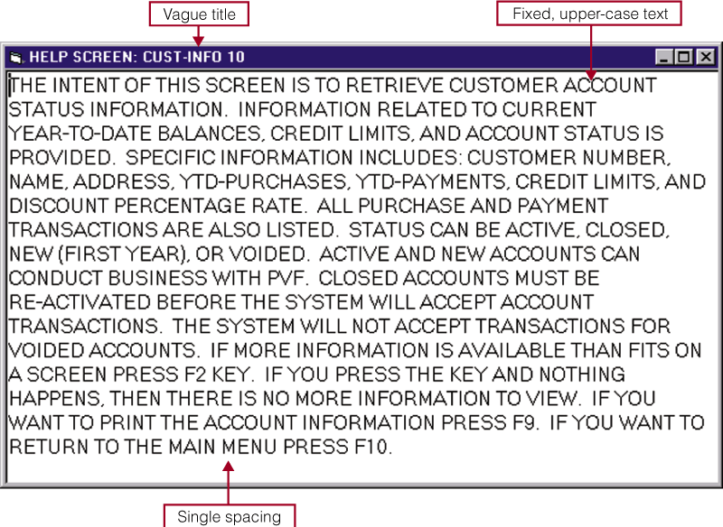
What it should not be
Figure 11-17 : Unattractive screen design
Systems Analysis & Design (4th Edition) – Shelly Cashman Series.

Slide 33
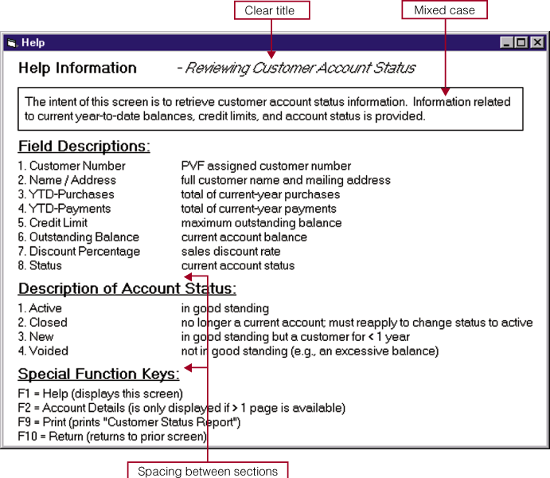
What it should be
Figure 11-18 : Attractive Screen Design
Systems Analysis & Design (4th Edition) – Shelly Cashman Series.

Slide 34
Summary of Main Teaching Points
Input Design
Input Design
Devices
Guidelines for form design

Slide 35
After the break
Output Design
Systems design
User Interface design

Slide 36
Topic & Structure of the lesson
Output Design
Systems design
User Interface design

Slide 37
Learning Outcomes
By the end of this lecture, YOU should be able to :
Identify the objectives of output design
List the guidelines in output design

Slide 38
Key Terms you must be able to use
If you have mastered this topic, you should be able to use the following terms correctly in your assignments and exams:
Detail Report
Exception Report
Summary Report

Slide 39
Output Design Objectives
Designing output to serve a specific purpose
Making output meaningful to the user
Delivering the appropriate quantity of output
Providing appropriate output distribution
Providing output on time
Choosing the most effective output method

Slide 40
Quick Review Question
Which of these is not one of six objectives for output?
serves a specific purpose
on time
available in unlimited quantity
using the most effective output method
Notes:
C

Slide 41
Guidelines in Output Design
Who is using the output?
What should the output be?
When should the output be?
How should the output be presented?
How much will it cost?

Slide 42
Guidelines in Output Design
User Involvement
Report Design Principles
Must be attractive, professional, and easy to read
Should provide totals and subtotals for numeric fields
Analyst must consider design features such as report headers and footers, page headers and footers, column headings and alignment, column spacing, field order, and grouping of detail lines
Report Headers and Footers
Every report should have a report header and a report footer
Header identifies the report, and contains the report title, date, and other necessary information
Footer can include grand totals for numeric fields and other end-of-report information

Slide 43
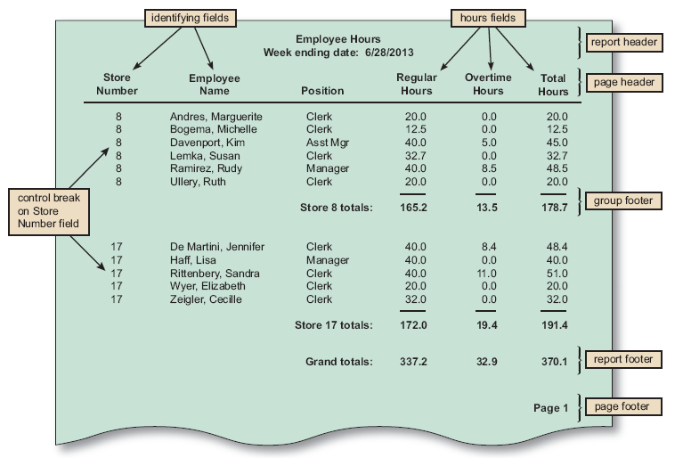
Guidelines in Output Design
FIGURE 8-20 The Employee Hours report is a detail report with control breaks, subtotals, and grand totals. Notice that a report header identifies the report, a page header contains column headings, a group footer contains subtotals for each store, a report footer contains grand totals, and a page footer identifies the page number

Slide 44
Guidelines in Output Design
Report Design Principles
Page Headers and Footers
Every page should have a report header and a report footer
Header includes the column headings that identify the data. The headings should be short but descriptive
Footer used to display the report title and the page number
Repeating Fields
The best advice is to ask users what they think and be guided accordingly
Consistent Design
Look and feel are important to users, so reports should be uniform and consistent

Slide 45
Considerations in Output Design
Main requirements in output design is that it meets the user requirements
Major function of output is to convey the information required by the user.
Therefore, the layout and design of the output is important.

Slide 46
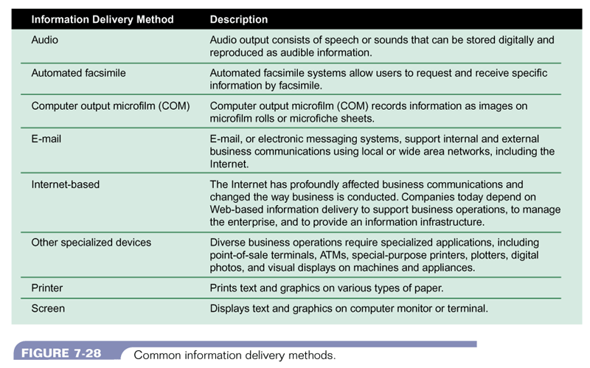
Output Methods
Figure 11-3 : Common information delivery methods
Systems Analysis & Design (4th Edition) – Shelly Cashman Series.

Slide 47
Quick Review Question
Which of these needs is to be considered when choosing an output method?
The cost of producing and providing/distributing the output
The accessibility of the output to the user
The flexibility in content and format of the output to the user
All of the above

Slide 48
Types of Report
Types of Reports
DETAIL REPORTS
Produces one or more lines of output for each record processed
Can be quite lengthy
A better alternative might be an exception report
EXCEPTION REPORTS
Displays only those records that meet a specific condition or conditions
Useful when the user wants information only on records that might require action, but does not need to know the details
SUMMARY REPORTS
Upper-level managers often want to see total figures and do not need supporting details

Slide 49
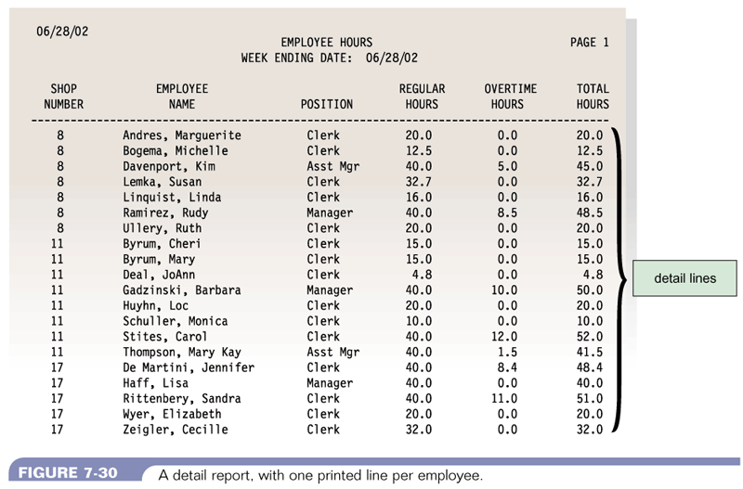
Types of Report - Detail Report
Figure 11-4 : A detail report with one printed line per employee
Systems Analysis & Design (4th Edition) – Shelly Cashman Series.

Slide 50
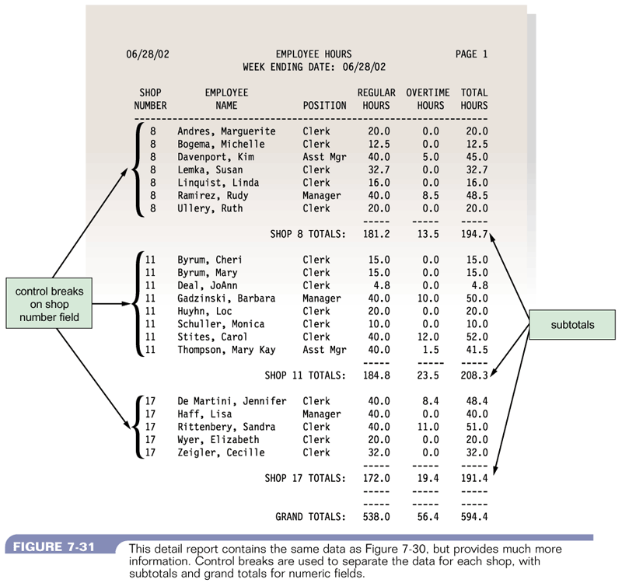
Detail Report
Figure 11-5 : A detail report with more information and using control break
Systems Analysis & Design (4th Edition) – Shelly Cashman Series.

Slide 51
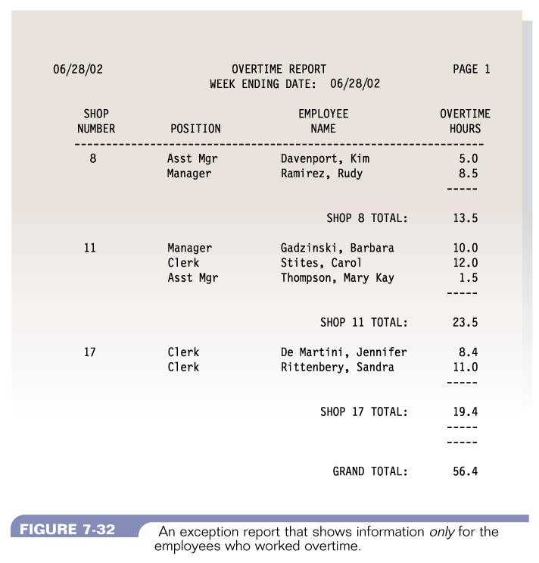
Exception Report
Figure 11-6 : A n exception report that shows information only for the employees who worked overtime
Systems Analysis & Design (4th Edition) – Shelly Cashman Series.

Slide 52
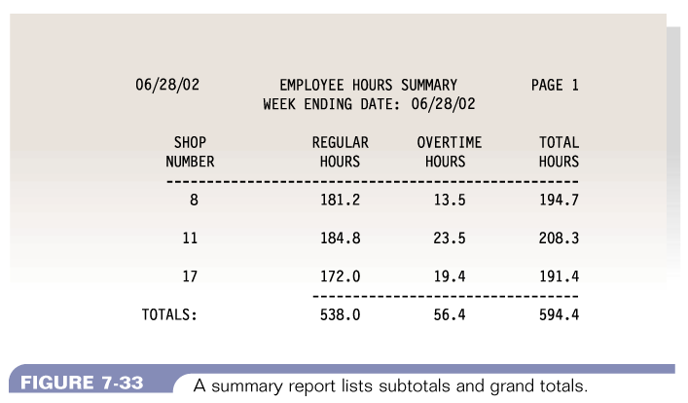
Summary Report
Figure 11-7 : A summary report lists subtotals and grand totals
Systems Analysis & Design (4th Edition) – Shelly Cashman Series.

Slide 53
Quick Review Question
The functional attributes of a printed report include:
The heading or title of the report
The page number
The date of preparation
The column headings
The grouping of related data items
All of the above.

Slide 54
Quick Review Question
The functional attributes of a printed report include:
The heading or title of the report
The page number
The date of preparation
The column headings
The grouping of related data items
All of the above.

Slide 55
Summary of Main Teaching Points
Output Design
Systems design
User Interface design

Slide 56
Question and Answer Session
Q & A

Slide 57
What we will cover next
Implementation
Coding Standards
Types of testing
Test plan

